Slide 1
Course - DT228-2
Module (Subject) -
Human Computer Interaction
Semester 2, Week 1
COURSE SUBJECT OVERVIEW

Slide 2
Lecturer Details
Dr Art Sloan
Office location: KE 1-013a
Phone No: 01 402 4972
E-Mail Art.Sloan@dit.ie
Web page: Webcourses
CMPU2008-A: DT228-2 Human Computer Interactation
Notes and news will appear here, from week to week. (All lecture notes will be available, as ‘links’, by @ Week 13)

Slide 3
Semester 2
Similar to semester 1 - 12 weeks and 1 Review Week. (Easter break – 2 weeks following Week 9)
Review Week (Reading Week): Week 13
30 April – 4 May
End of Semester 1: 18 May 2018 including Exam Weeks

Slide 4
Lecture and Lab Times
Thursdays
Lecture 1 – 4.00-5.00pm KE-3008
Labs 2.00-4.00pm
Group A – AU1-005, Art
Group B – KA 3-008, Dave Carroll
Group C – KA 1-016, Edina H Webster
Fridays
Lecture 2 – 10.00am -11.00 KE-2008

Slide 5
Module Aims
The aim of this module is to:
Enable students to understand human behaviour with interactive objects;
Provide students with the skills to develop and evaluate interactive software using a human-centred approach;
Provide students with an appreciation of human diversity and the need for accessibility and its implications for HCI design.

Slide 6
Learning Outcomes
On completion of this module, you will be able to:
Discuss the background of HCI with its underpinnings from psychology and cognitive science;
Select appropriate Input-Output devices and interaction styles to support users and their tasks;
Employ a range of user centred design techniques which use established design principles and methodologies to solve HCI problems;

Slide 7
Learning Outcomes (2)
Employ a range of low-fidelity and high-fidelity prototyping techniques;
Employ a range of evaluation techniques;
Discuss accessibility issues and their implications for user interface design.

Slide 8
Why do I need this module??
(‘I’ means ‘You’!)

Slide 9
Module Description
Human Computer Interaction (HCI) emphasises the significance of good interfaces and the relationship of interface design to successful human interaction with computer systems.
This module provides the theoretical knowledge and practical experiences in the fundamental aspects of:
Analysing, designing, prototyping, and
evaluating user interfaces based on sound HCI principles.

Slide 10
Module Content
Fundamentals of Human Computer Interaction – the Scope and interdisciplinary nature of HCI
Human capabilities; user groups
Cognitive Foundations Metaphors; mental models; perception; attention; memory; learning
User interface technology - input and output devices, interaction styles
User-centred design process - HCI design process vs. software engineering design process
Usability guidelines, principles and theories

Slide 11
Module Content (2)
User interface design and prototyping using User Centered Design; participatory design; screen design; low-fidelity, medium-fidelity and high-fidelity prototyping design principles and rules
User interface evaluation: Usability specifications. Measurement criteria. Usability evaluation; cognitive walkthroughs, heuristic analysis, expert review, ‘think aloud’ methods
Usability issues and accessibility, Ease of use. Principles of universal design, usability standards, HCI standards, accessibility requirements, implications for HCI and the legal imperative for accessibility

Slide 12
Lecture Topics
Week 1 - Users and Interfaces
Week 2 - Perception and Cognition
Week 3 - Attention and Memory
Week 4 - Design Process
Week 5 - Interface Design (Prototyping)
Week 6 - Ubiquitous Computing
… continued/

Slide 13
Lecture Topics
Week 7 - User Centred Design
Week 8 - Interaction Styles
Week 9 - Screen Design
Week 10 - Application Areas and Case Study
Week 11 - Accessibility issues
Week 12 - Usability Evaluation
Week 13 - Revision

Slide 14
COURSE MATERIALS
Lecture Notes -
available on Webcourses

Slide 15
SELF REGISTRATION
Webcourses -
The module is:
CMPU2008-A: DT228-2 Human Computer Interaction
There is NO self registration password

Slide 16


‘Essential’ Reading
Preece, J. et al (2002), Interaction Design, John Wiley & Sons.
Norman, D. (2002,) The Design of Everyday Things, Basic Books.

Slide 17
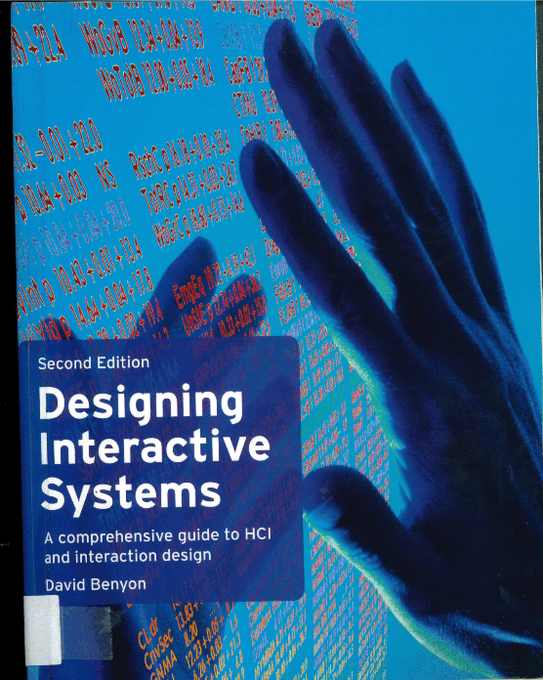
‘Essential’ Reading
Preece, J. et al (2002), Interaction Design, John Wiley & Sons.
Norman, D. (2002,) The Design of Everyday Things, Basic Books.

Slide 18
Supplemental Reading
Benyon, D. (2010), Designing Interactive Systems, Pearson.
Shneiderman, B. & Plaisant, C. (2010), Designing the User Interface, Pearson.
Dix, A., Finlay,J., Abowd, G., & Beale, R. (2004), Human Computer Interaction, 3rd Ed, Prentice Hall.

Slide 19



Supplemental Reading

Slide 20
COURSE ASSESSMENTS

Slide 21
COURSE ASSESSMENTS (2)
Online Quiz –
WEEK 7, during lab time
Individual
Assignment –
A small interface design project
WEEK 9 – 11
Group work
Exam –
WEEK 14 or 15

Slide 22
Websites and Journals
Jakob Nielsen's Website
http://www.useit.com/
Donald Norman's Website
http://www.jnd.org/
Ben Shneiderman's Website
https://www.cs.umd.edu/users/ben/index.html
ACM SIGCHI (Special Interest Group on Computer-Human Interaction) http://www.sigchi.org/

Slide 23
The END
That is the Module Introduction
Are there any questions?

